Slide 1

US ACCIDENTS
(2016–2022)
National Trends
From nationwide patterns to city, specific risk factors

Slide 2
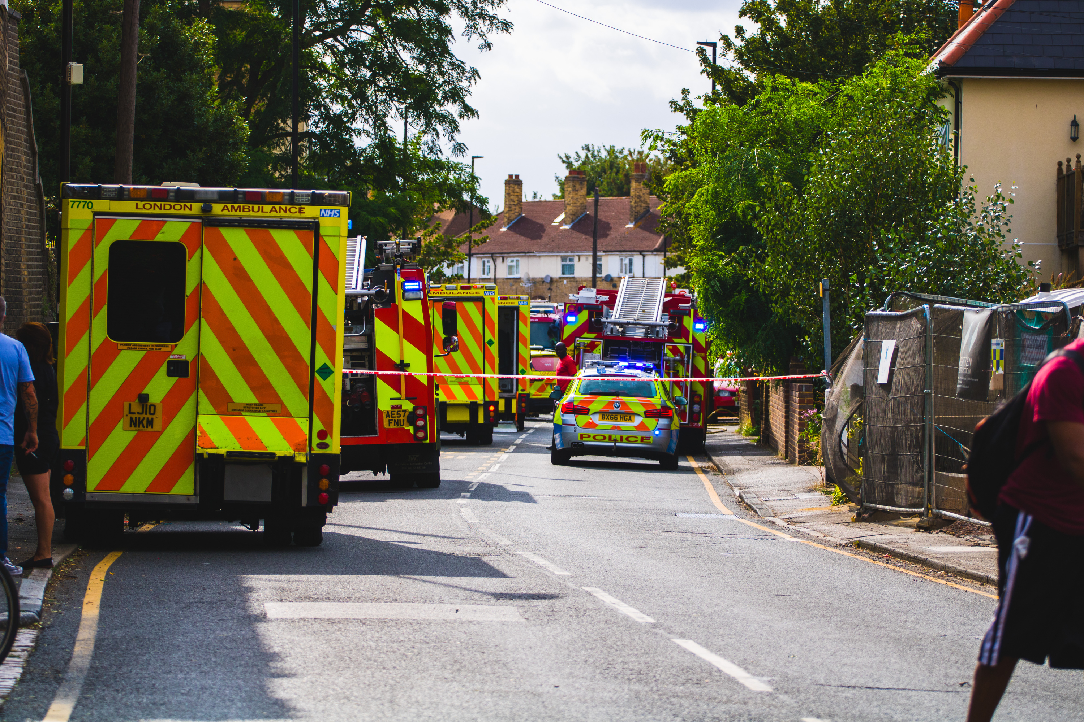

Did You Know?
6 million
Every year, over traffic accidents are reported in the U.S, that’s more than accidents every single day.
16,000
Myth:
“Most people think accidents mostly happen at night”

Slide 3

Did You Know?
December is the riskiest month for accidents
39%
than the average month

Slide 4
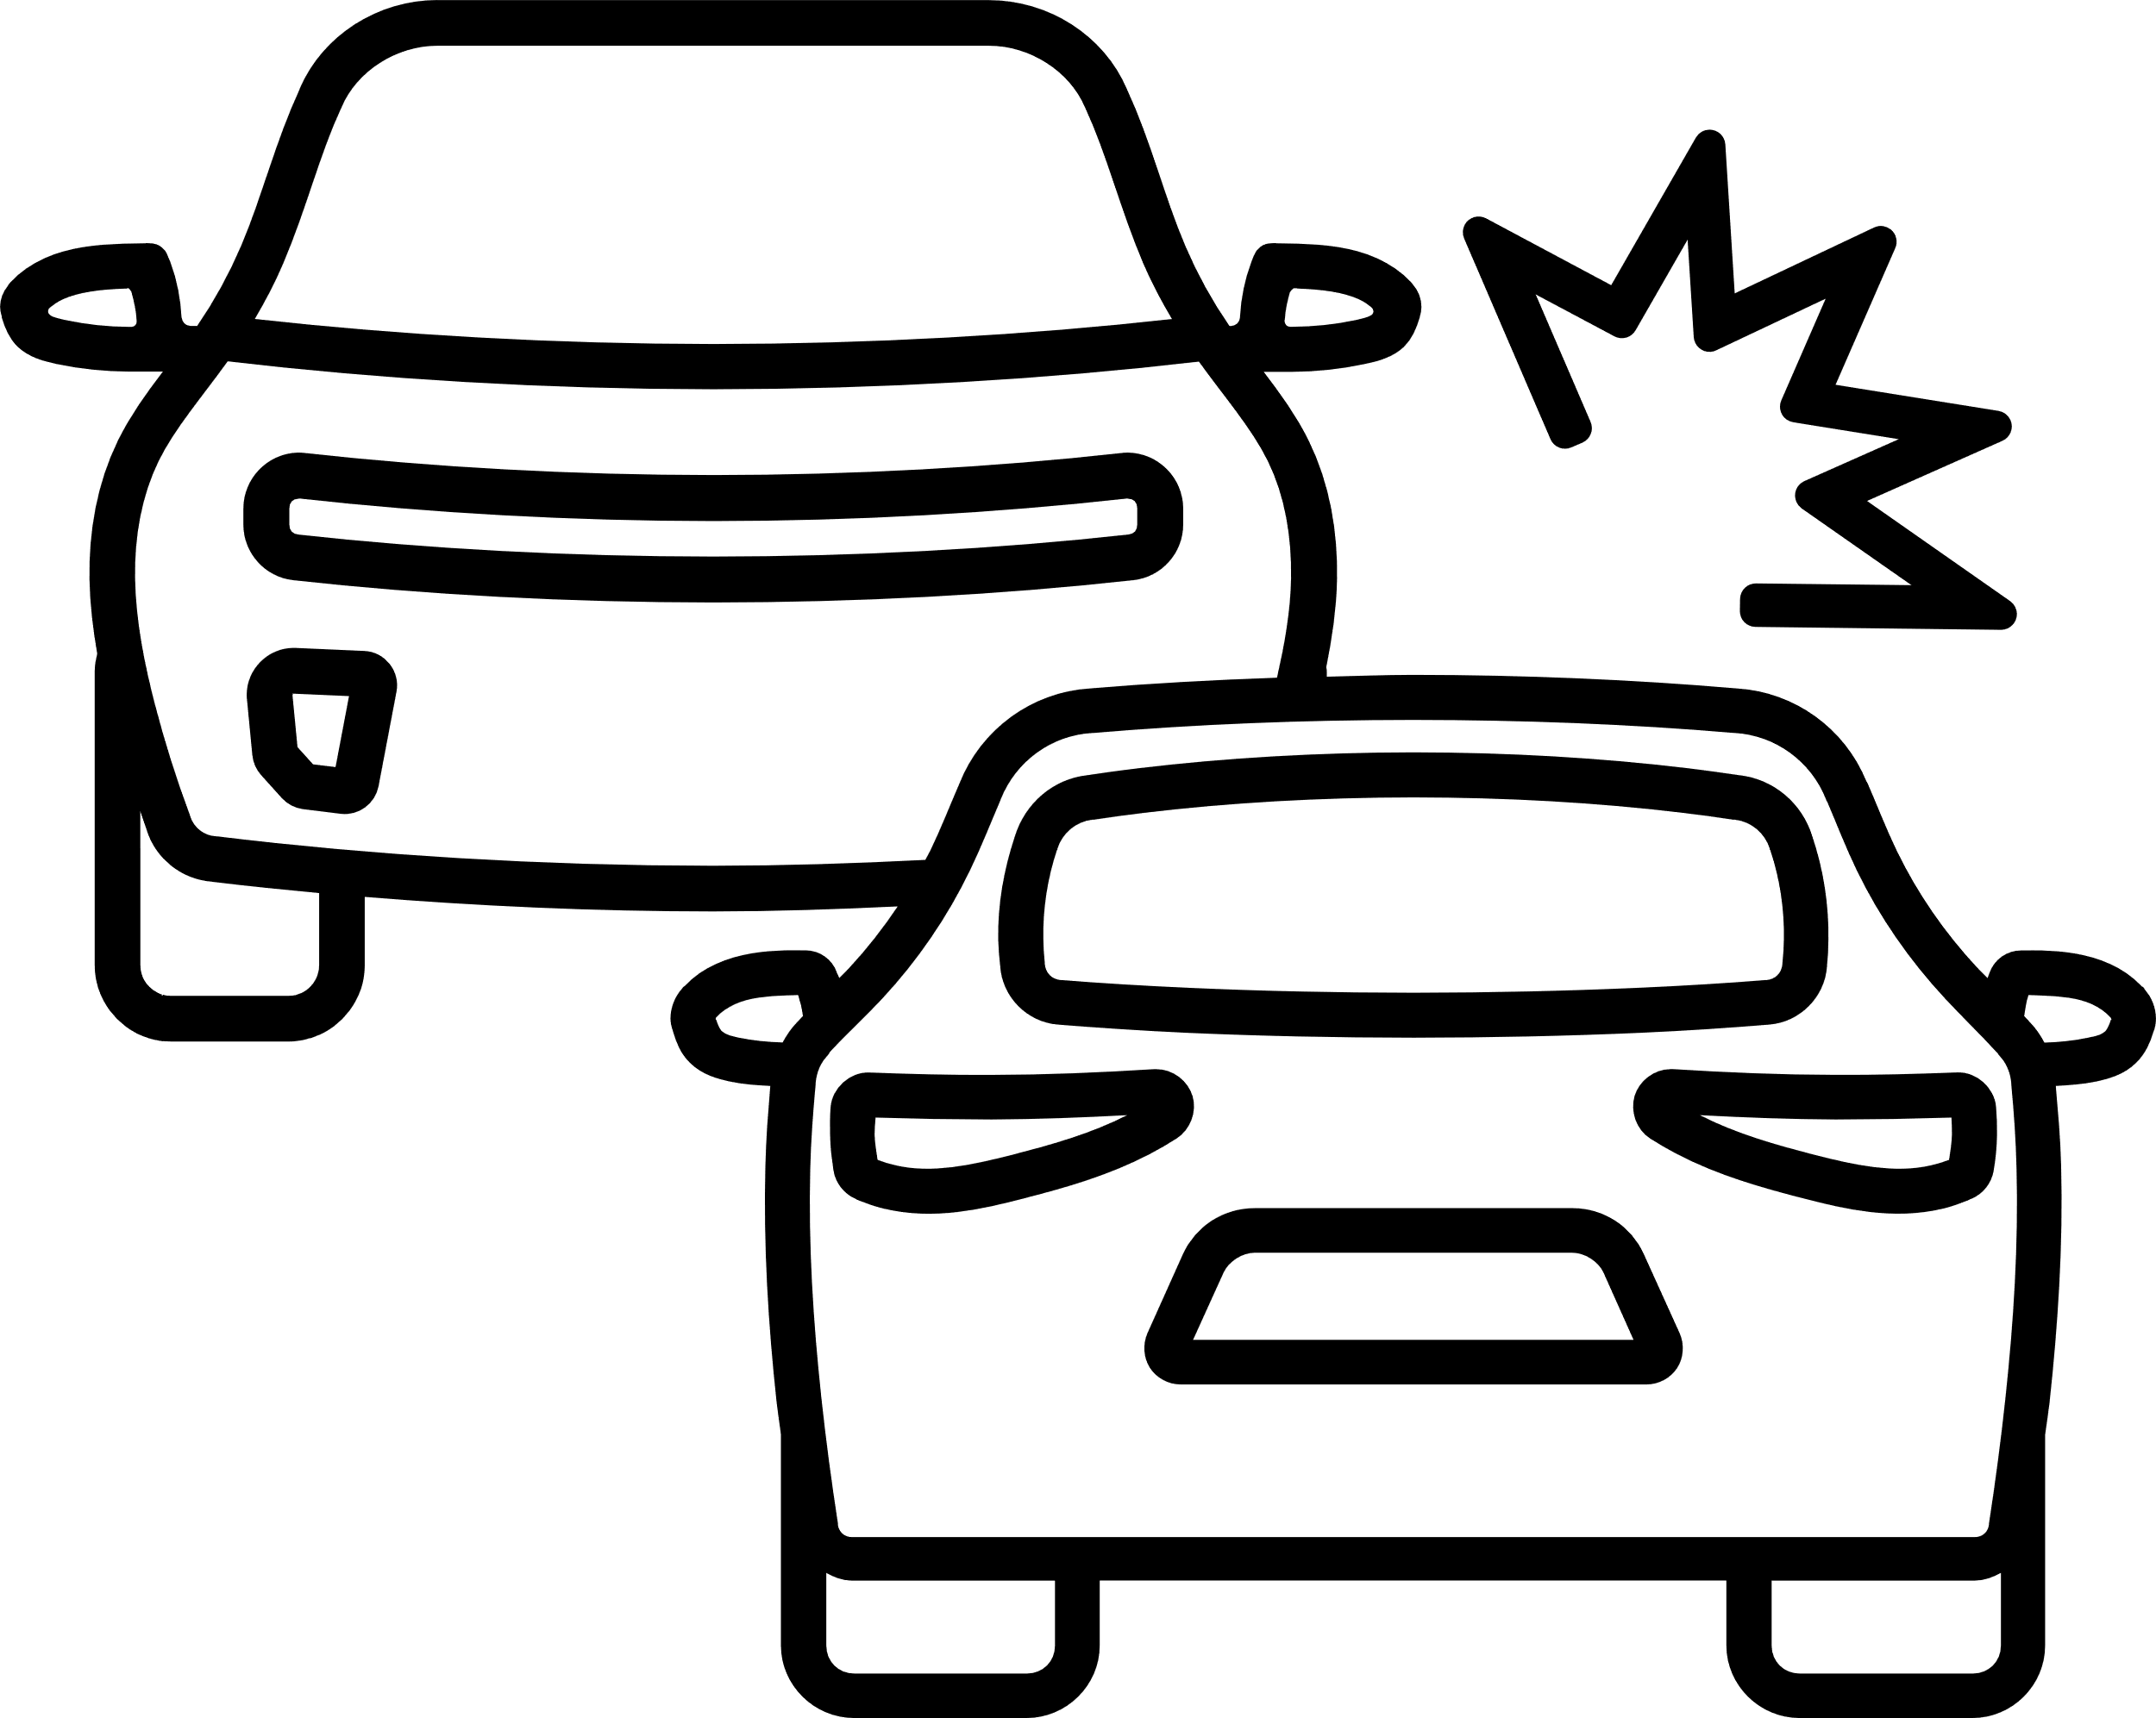
Project
Overview
We Use:
US Accidents DataSet - Kaggle
We analyze:
500K
49
Accidents
Records
6Yr - Trend & Pattren
US States
2016 to 2022

Slide 5
Project
Overview
We Explore:
Which states have the most accidents, and their distribution.
Patterns:
Location
Time of Day
Week
vs
Weekend
Day
vs
Night
weather conditions
Objective:
Extract key insights to Improve Safety analysis, traffic planning.

Slide 6
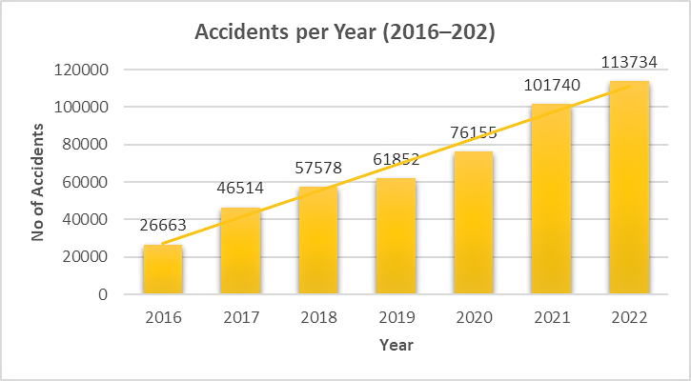
Trend Over Time
27.7%

Slide 7
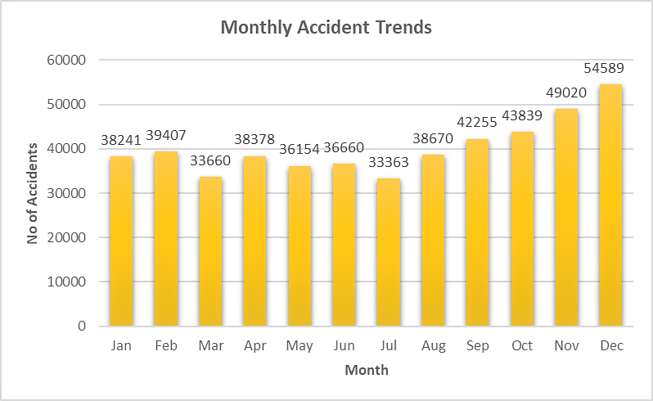
Trend Over Time
39%

Slide 8
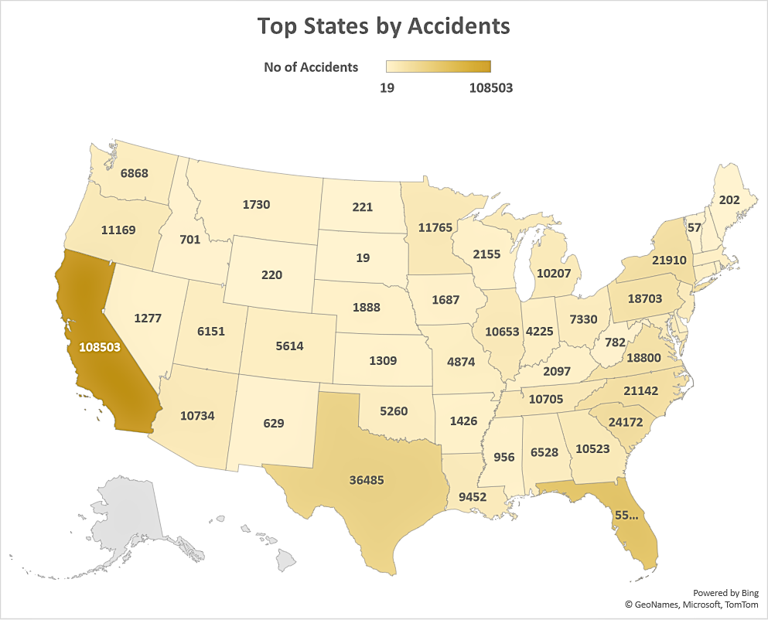

Geographical Focus
17x
California
CA
1.7 H Avg D
TX
FL

Slide 9
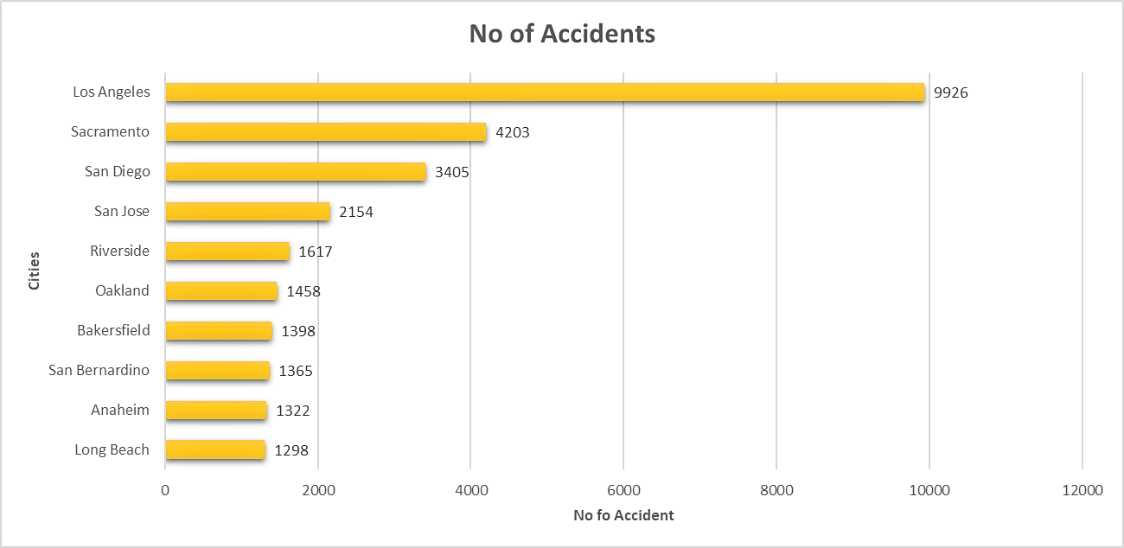
Geographical Focus
390%

Slide 10
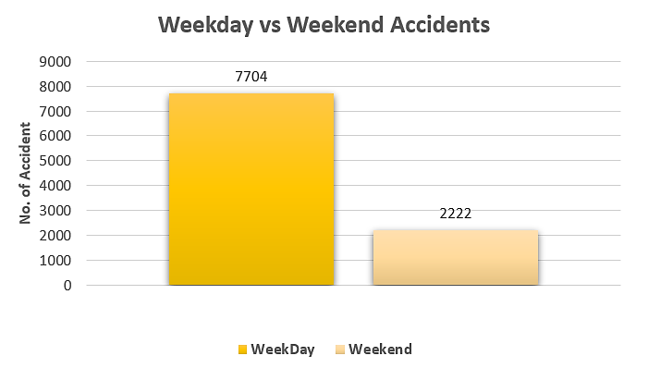
LA- Deep Dive

Slide 11
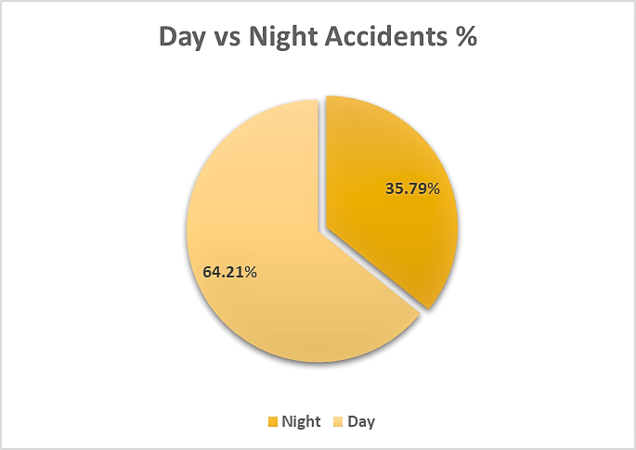
LA- Deep Dive

Slide 12
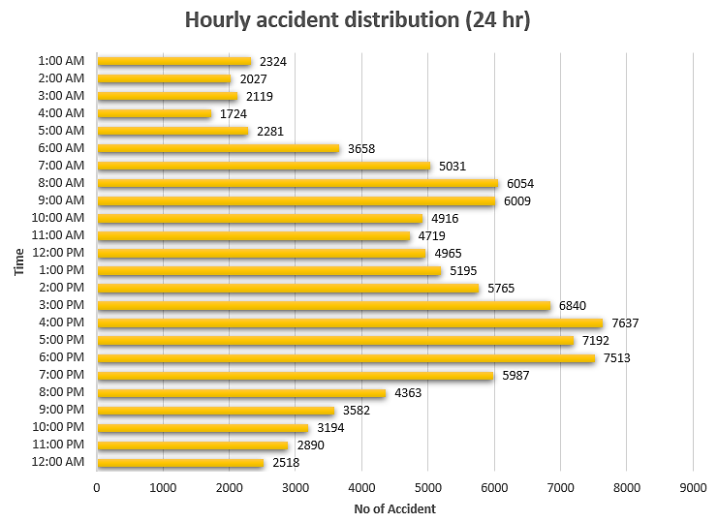
LA- Deep Dive

Slide 13
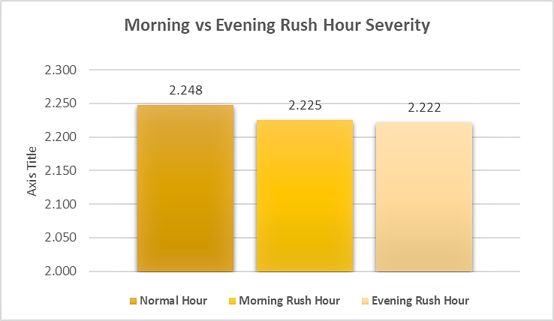
LA- Deep Dive
Notes:
Severity refers to the severity of a crash. It shows how much people get hurt or even die, and how strongly the accident changes their lives.

Slide 14
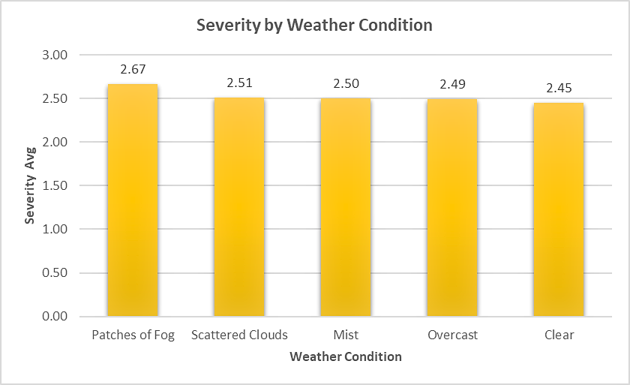
LA- Deep Dive

Slide 15
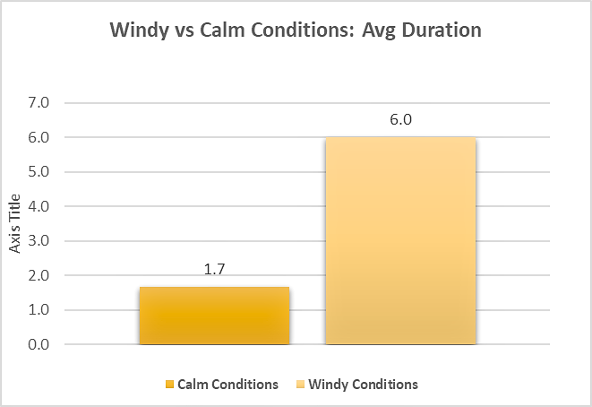
LA- Deep Dive

Slide 16
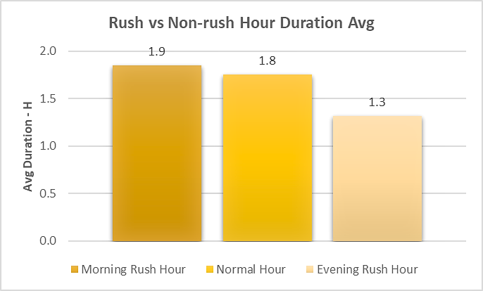
LA- Deep Dive
Notes:
Average duration means the usual time something lasts. For accidents, we look at when they start and end, add up all the times from many accidents, then divide by the number of accidents. This tells us how long an accident usually takes before the road is clear.

Slide 17
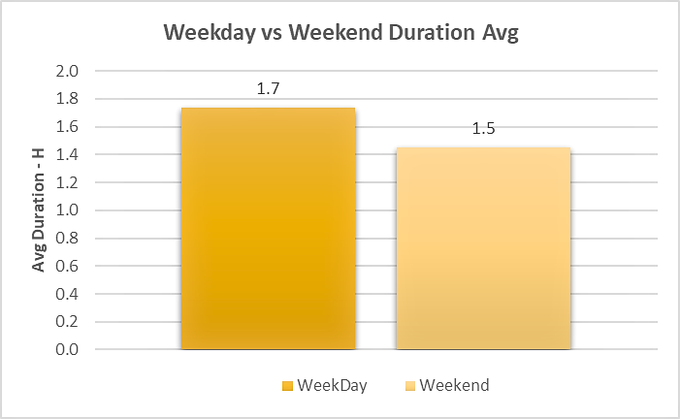
LA- Deep Dive

Slide 18
Conclusion
Accidents have risen steadily from 2016 to 2022, with clear seasonal peaks (December being the highest).
California, especially Los Angeles, is a major hotspot with high accident counts and severity.
Time factors, including weekends, night-time, and evening rush hours, show a higher risk.
Weather plays a role in increasing accident severity, particularly in cloudy and foggy conditions.
Accident clearance duration: weekends, nights, and rush hour have more prolonged delays.
By analysing these patterns, we can not only understand when and where accidents are most likely but also propose measures to improve road safety and emergency response.

